Slide 1

The Candid Conversation Series: Understanding Gender Pronouns & Creating Safe Spaces at Work
LGBTQIA+ Pride Month
Wednesday June 22, 2022
Notes:
Speaker: Kat

Slide 2


Thank You Sponsors!

Slide 3
Community Agreement
At BOMA San Francisco, we believe in creating a safe environment for all our members.
Be Curious, Open, & Respectful - We throw sunshine, not shade.
No one knows everything - Together we know a lot.
Confidentiality - Don’t speak for others without explicit permission, don’t share something communicated in a private or safe space.
One mic - One voice at a time
Take Space / Make Space - If you’re usually quiet challenge yourself to take more space. If you’re usually talking, be mindful to listen for other voices.
Avoid Jargon, Acronyms, and Industry language - Use inclusive language that is accessible for people with varying inside knowledge
Be aware of time
Speak from your own experience
Be conscious of intent vs. impact - no matter the intention, you’re responsible for your impact
https://nesawg.org/conference/community-agreements

Slide 4
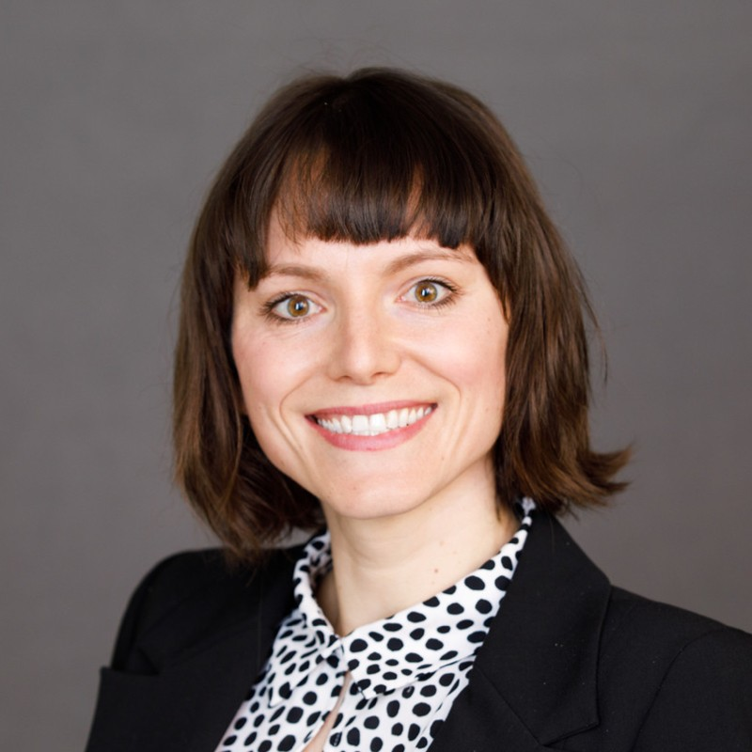

Panelists
Alexandra “Ali” von Klan (She, Her, Hers)
  Chair of Otis Pride, LGBTQIA+ Employee Resource Group
  Project Manager at Otis Elevator Company, “Best Places to Work for LGBTQ+ Equality”
  B.A. in Gender and Women’s Studies & American Studies, UC Berkeley
  MBA Candidate, UC Davis
Meredith Campbell (She, Her, Hers)
  Founder and Chair of LGBTQ+ Employee Resource Group
  Change Management and Business Solutions Consultant
  Masters in Organizational Psychology, undergrad Accounting
  Volunteers with LGBTQ+ non-profit and local Social Justice Committee
Notes:
Speaker: Ali and Meredith

Slide 5
Overview
Overview of LGBTQIA+ Workplace Issues
Benefits of Inclusion
Why Pronouns Matter?
Safe(r) Spaces
Next Steps for Allyship
Notes:
Speaker: Meredith

Slide 6
Introduction
The significance of LGBTQIA+ Pride Month
  What is LGBTQIA+ Pride Month?
  Why does the United States celebrate it?
Our stories -
  What LGBTQIA+ Pride means
  Why it is important
Notes:
Speaker: Ali
Mention LGBTQIA+ vs LGBTQ+

Slide 7

Imagine for a moment…
Notes:
Speaker: Meredith
How many of you have or had a photo of your family at your desk in the office?
Take a moment, and remember why you chose that photo, and what it means to you.
Imagine, for a moment, that you were in a non-heterosexual relationship. Would you feel comfortable showing a photo of you and your spouse at work?
Research shows that many LGBTQIA+ employees find it “easier” to not mention the name of their same sex partner in order to not out themselves at work. Imagine, for a moment, that you could never mention the name of your spouse or significant other due to fear of discrimination. This “invisible stigma” can lead to individuals feeling unsafe to share parts of themselves, as they are continually assessing if it is safe to reveal their sexuality.
This is why this meeting and meetings like this, Affinity or Employee Resource Groups, are so important. Simply having discussions about LGBTQIA+ equality in the workplace shows support to those in the community.

Slide 8
LGBTQIA+ in the Workplace
Approximately 1/5 of LGBTQIA+ Americans have experienced hiring discrimination based on their gender identity or sexual orientation
  Over half (53%) have heard offensive jokes
  Almost half (46%) choose to be closeted at work
Over half (59%) of non-LGBTQ+ employees believe its “unprofessional” to discuss gender identity or sexual orientation in the workplace, leading to self-censoring of their LGBTQIA+ colleagues
Notes:
Speaker: Ali
Define masking and what that is

Slide 9
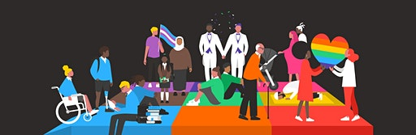
Benefits of Inclusion
When companies make efforts to support and include minority employees, this is typically correlated with increased job satisfaction, employee engagement, organizational commitment, and better performance outcomes
LGBTQIA+ inclusive practices can increase perceived organizational support, productivity, satisfaction, and can also be correlated with better financial performance
Increasing support to potentially marginalized employees is expected to reduce employee absenteeism, discrimination, and litigation within organizations
People who are allowed to freely share their unique gifts and talents at work are both happier and more productive
Notes:
Speaker: Meredith

Slide 10
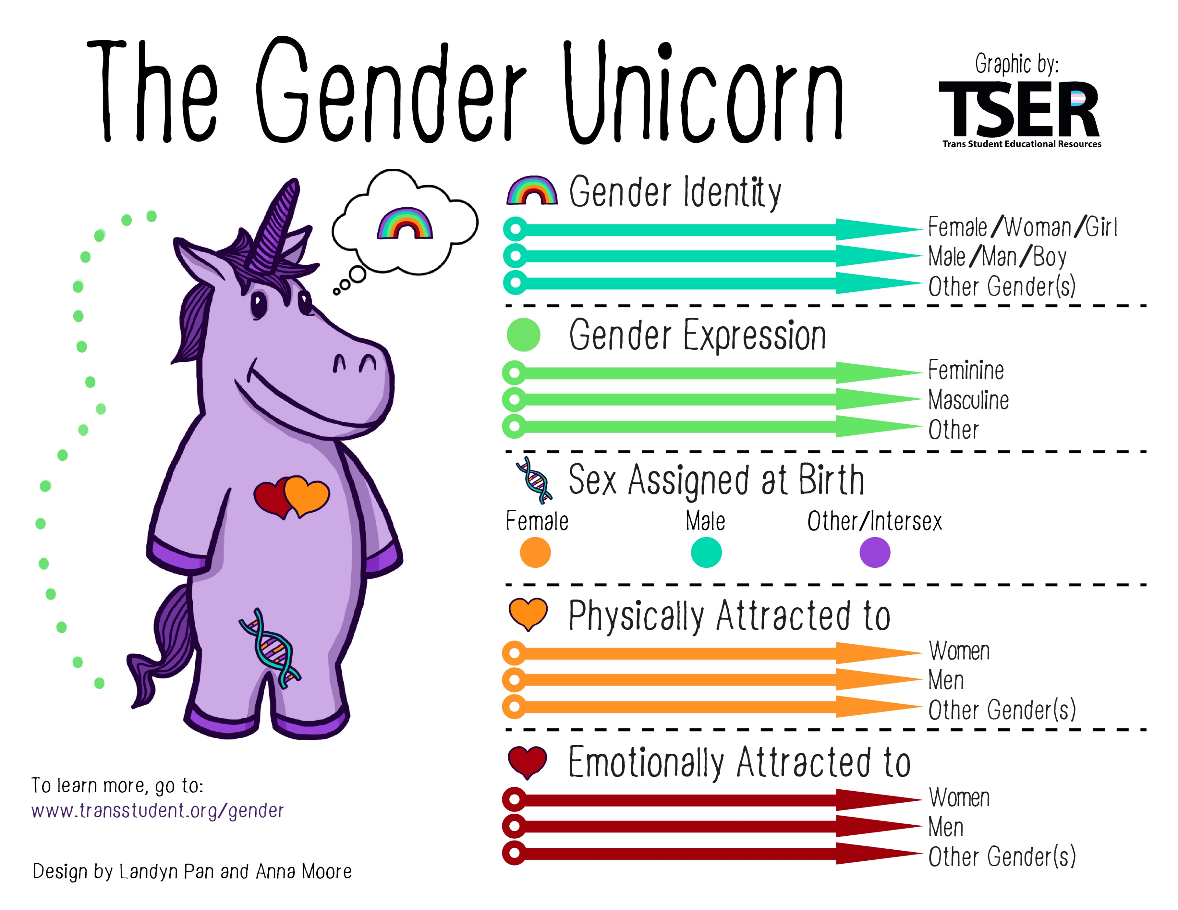
Notes:
Speaker: Ali
Understanding the different classifications around sex, gender, sexual orientation is useful before embarking on discussion on pronouns in the workplace
There are more than 2 genders!

Slide 11
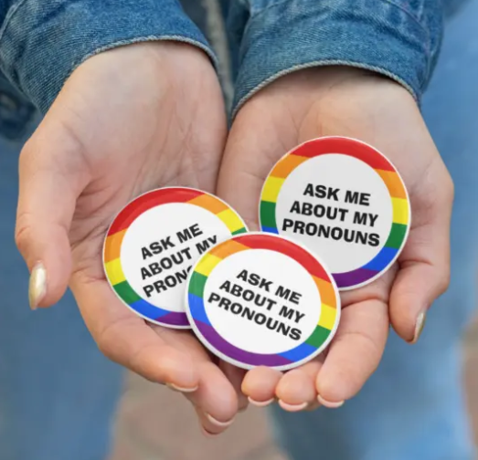
Pronouns
Common third person pronouns:
She/Her/Hers
He/Him/His
They/Them/Theirs
She/Her/They
….unsure, just ask!
Notes:
Speaker: Ali
More and more, we are seeing the use of pronouns in both professional and personal settings.
We want to create a strong sense of belonging and authenticity for everyone in the workplace, simply put.
Pronouns are used in daily conversations and defined as a word that refers to the people talking, “I” or “You”, or someone or something being talked about. “
Common third person pronouns are, “She/Her/Hers”, “He/Him/His”, “They/Them/Theirs”
Normalizing pronoun disclosure sets a tone that an organization promotes a respectful work environment.

Slide 12
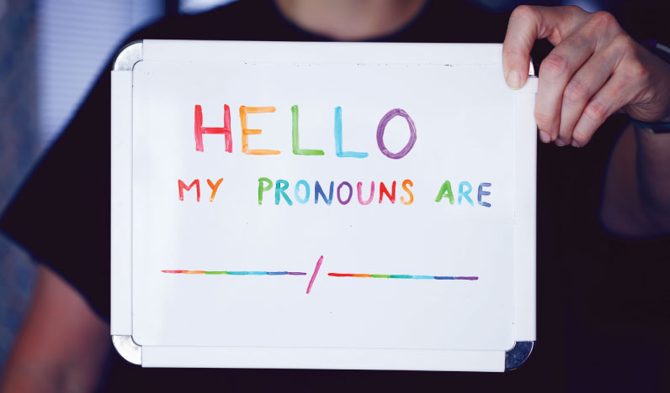
Why Do Pronouns Matter?
Pronouns are fundamental to a person’s identity
Failing to acknowledge a person’s pronouns, or misgendering a person, results in erasure or feeling unseen
Respecting a customer or colleague pronouns is viewed as a sign of support for LGBTQIA+ community and creates a culture of inclusion
Disclosing pronouns eliminates assumptions based on perceived gender
Notes:
Speaker: Ali

Slide 13

Safe Spaces at work
Safe space – a place intended to be free of bias, conflict, criticism, or potentially threatening actions, ideas, or conversations
Merriam-Webster
Allowing individuals to show up as themselves and not fear judgement or retaliation
Allowing individuals to ask questions without fear of judgement
Will take time to establish and develop
Baby steps
Leverage events like this one and ask your questions!
Create a space or meeting to talk openly about obstacles preventing individuals in the LGBTQIA+ community from being open
Activate allies to do some of the heavy lifting in showing support
Notes:
Speaker: Meredith
It’s tough to argue your own rights
50-75% allies – Wequal Wendys, 50% allies in Ohio ERGs
Not just in June, but year round

Slide 14
Being an LGBTQIA+ Ally
Ally – an individual who is supportive and accepting of the LGBTQIA+ community and challenges personal and/or systemic discrimination
How to be a better ally in the workplace
  Bring awareness of LGBTQIA+ issues and concerns to conversations about diversity and inclusion
  Challenge biases and phobias
  Do not make assumptions or generalizations
  Consider a rainbow flag or sticker to visibly show you are an ally to your colleagues
Notes:
Speaker: Meredith
By being an active ally is willing to act with and for others in the efforts of ending oppression and creating equality. you can help decrease discrimination and harassment that happens to towards the LGBTQ+ community by using correct pronouns, learning LGBTQ+ history, challenging others to use proper pronouns of LGBTQ+ individuals when they are and not present, supporting LGBTQ+ spaces and legislations.

Slide 15

Action Steps to Becoming an Ally
Know the issues
  Learn the history
  Learn of the obstacles
Know yourself
  Be willing to make mistakes
  Get comfortable with being uncomfortable
  Check your privilege
Build relationships
  Include your LGBTQIA+ friends and family
  Be open to new experiences and ideas
Notes:
Speaker: Meredith
Privilege – not a bad thing and doesn’t mean life hasn’t been hard. Doesn’t mean that you haven’t had to work. Just means that your life has not been made harder in some way or area

Slide 16
Maya Angelou
“I did then what I knew how to do. Now that I know better, I do better.”
Notes:
Speaker – Ali

Slide 17

We all make mistakes…..
Oops, I made a mistake, what now?
Do not agonize over your mistake
Apologize quickly and once per incident
Do not continuously apologize; an understanding nod, an apology to the correct person, then resume the conversation using proper verbiage
Notes:
Speaker: Meredith
Pronoun they/them examples, working through correcting others, etc.

Slide 18
Thank You

Slide 19
Questions & Answers
Alexandra von Klan
Alexandra.vonKlan@otis.com
Meredith Campbell
meredithspeakslgbtq@gmail.com

Slide 20


SAVE THE DATE
You’re Invited!
2022 BOMA DEI Scavenger hunt
You’re Invited
2022 DEI Scavenger Hunt
JULY 21, 2022
4:00PM – 6:00PM
Thursday, July 21st, 2022
4PM – 6PM
500 Howard Street

Slide 21
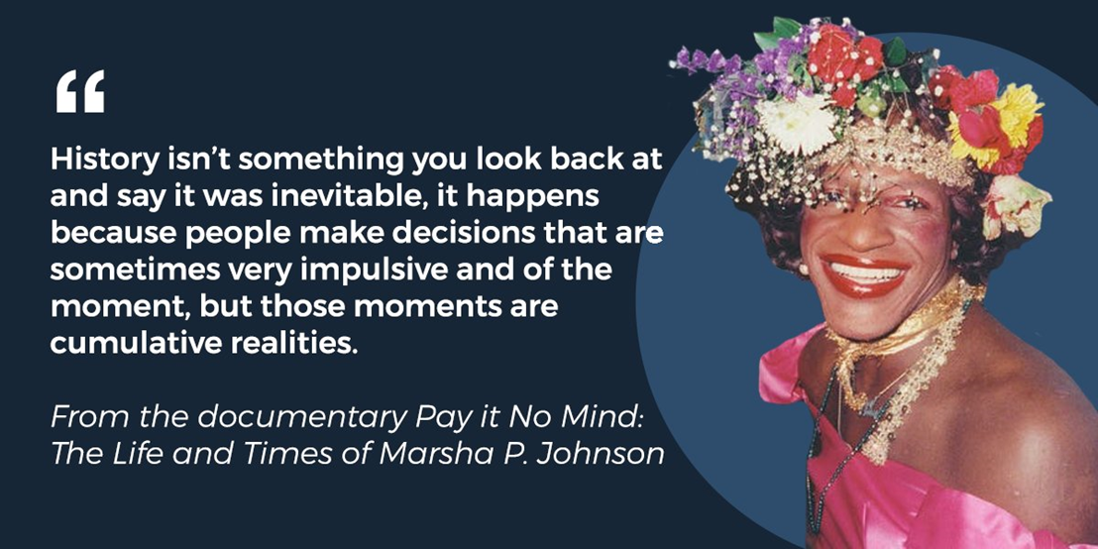
Resources
Equality Toledo – www.equalitytoledo.org
Spanish Language Resources – https://gustavus.edu/diversity/LatinxResources.php
American Civil Liberties Union (ACLU) – www.aclu.org
Association for LGBT Issues in Counseling – www.algbtic.org
Bisexual Resource Center – www.biresource.org
Gay & Lesbian Alliance Against Defamation (GLAAD) –www.glaad.org
GLBT National Help Center – www.glbtnationalhelpcenter.org
Gay, Lesbian, Straight Education Network (GLSEN) – www.glsen.org
Gay-Straight Alliance Network – www.gsanetwork.org
Human Rights Campaign – www.hrc.org
It Gets Better Project – www.itgetsbetter.org
Lambda Legal – www.lambdalegal.org
LGBT Racial Equality – www.lgbtracialequality.org
Matthew Shepard Foundation – www.matthewshepard.org
National Youth Advocacy Coalition – www.nyacyouth.org
National Center for Lesbian Rights – www.nclrights.org
National Gay and Lesbian Task Force – www.ngltf.org
NOH8 Campaign – www.noh8campaign.com
Parents, Families and Friends of Lesbians and Gays (PFLAG) – www.pflag.org
The Advocate – www.advocate.com
The Trevor Project – www.thetrevorproject.org
Trans Family – www.transfamily.org
Notes:
Research bibliography –
ACLU (2020). Stonewall at 50, ACLU at 100. A Legacy of Fighting for Justice and Equality. ACLU. https://www.aclu.org/issues/lgbt-rights/stonewall-50-aclu-100-legacy-fighting-justice-and-equality
Aritonovich, D. (2020, June 11). The Importance of Allies in LGBTQ+ Employee Resource Groups. Seminar presented at the Ohio Diversity Council LGBTQ+ Virtual Unity Summit
Brown, B. (2018) Dare to Lead [Audible audiobook]. Retrieved from www.amazon.com
Burn, I. (2018). Not all laws are created equal: legal differences in state non-discrimination laws and the impact of LGBT employment protections. Journal of Labor Research. 39(4), 462-497. DOI:10.1007/s12122-018-9272-0
Colgan, F. (2012). Visibility and voice in organisations. Equality, Diversity and Inclusion: An International Journal. 31(4). 359-378. DOI:10.1108/02610151211223049
Cooper, K. (2018). Top leaders need to support LGBTQ employees. Indianapolis Business Journal. 38(52). https://libill.hartford.edu:2204/abicomplete/docview/2010766328/7910CDE828DB4784PQ/6?accountid=11308
Diaz, M. (2020, June 11). Culturally Competent Care of the LGBTQ+ Community and Best Practices. Seminar presented at the Ohio Diversity Council LGBTQ+ Virtual Unity Summit
Diversity Primer. (2009). Employee Network and Affinity Group. Diversity Best Practices. shttps://www.diversitybestpractices.com/sites/diversitybestpractices.com/files/import/embedded/anchors/files/diversity_primer_chapter_10.pdf
Dutton, K. (2018). Increasing diversity, awareness, and inclusion in corporate culture: investigating communities of practice and resource groups among employees. Development and Learning in Organizations, 32(6), 19-21. DOI:10.1108/DLO-11-2018-132
Esseks, J. (2020, June 15). Supreme Court Says Firing Workers Because They Are LGBTQ Is Unlawful Discrimination. ACLU. https://www.aclu.org/news/lgbt-rights/supreme-court-says-firing-workers-because-they-are-lgbtq-is-unlawful-discrimination/
Eyre, P. (2019, June 5). Why business can’t afford not to be inclusive. Training Journal. https://www.trainingjournal.com/articles/opinion/why-businesses-can%E2%80%99t-afford-not-be-inclusive
Glassman, A.M. & Glassman, M. (2017). The use of affinity groups by Fortune 100 firms. The Journal of Business Diversity. 17(2), 104-114. http://libill.hartford.edu:2048/login?url=https://libill.hartford.edu:2324/docview/1949477018?accountid=11308
Gold, M. (2018, June 21). The ABCs of L.G.B.T.Q.I.A.+. The New York Times. https://www.nytimes.com/2018/06/21/style/lgbtq-gender-language.html
Green, W. M., (2018). Employee resource groups as learning communities. Equality, Diversity and Inclusion: An International Journal. 37(7), 634-648. DOI:10.1108/EDI-11-2016-0085
Hammond, T. (2018) LGBTQ+ accountants: a call for oral history research. Sustainability Accounting, Management and Policy Journal. 9(5), 615-624
Holmes, O., Jiang, K., Avery, D., McKay, P., Oh, I., & Tillman, C. (2020). A Meta-Analysis Integrating 25 Years of Diversity Climate Research. Journal of Management. https://doi.org/10.1177/0149206320934547
Human Resource Management International Digest. (2019). ERGs (employee resource groups) benefit employee wellbeing. Human Resource Management International Digest, 26(1), 45-46. DOI:10.1108/HRMID-02-2019-0028
Jones, S.E. (2020). Negotiating transgender identity at work: a movement to theorize a transgender standpoint epistemology. Management Communication Quarterly. 34(2), 251-278. http://libill.hartford.edu:2109/10.1177/0893318919898170
Kleintop, L.K. (2019). When transgender employees come out: perceived support and cultural change in the transition process. The Journal of Business Diversity. 19(5), 55-67. URL http://libill.hartford.edu:2048/login?url=https://libill.hartford.edu:2324/docview/2358457583?accountid=11308
Leu, A. (2020, June 11). Starting an LGBTQ+ Employee Resource Group Within Your Organization. Seminar presented at the Ohio Diversity Council LGBTQ+ Virtual Unity Summit
Liswood, L. (2010). The Loudest Duck. Wiley. Hoboken, New Jersey.
Martinez, L. R., Sayer, K. B., Thoroughgood, C. N., Ruggs, E. N., & Smith, N. A. (2017). The importance of being “Me”: The relation between authentic identity expression and transgender employees’ work-related attitudes and experiences. Journal of Applied Psychology, 102(2), 215-226. http://libill.hartford.edu:2109/10.1037/apl0000168
Miano, A. (2017, April 11). FullConTech 2016 Play: Creating powerful Employee Resource Groups (ERGs). Washington Technology. https://www.washingtontechnology.org/creating-powerful-employee-resource-groups-ergs/
Pichler, S., Blazovich, J. L., Cook, K. A., Huston, J. M., & Strawser, W. R. (2018). Do LGBT-supportive corporate policies enhance firm performance? Human Resource Management, 57(1), 263–278. https://doi.org/10.1002/hrm.21831
Pichler, S. & Holmes, O. (2017). An investigation of fit perceptions and promotability in sexual minority candidates. Equality, Diversity and Inclusion: An International Journal. 36(7), 628-646. DOI:10.1108/EDI-02-2017-0037
Pichler, S., Ruggs, E., & Trau, R. (2017). Worker outcomes of LGBT-supportive policies: a cross-level model. Equality, Diversity and Inclusion: An International Journal. 36(1), 17-32. DOI:10.1108/EDI-07-2016-0058
Prosci. (2020). Executive Sponsor's Importance and Role. Prosci, Inc. https://www.prosci.com/resources/articles/importance-and-role-of-executive-sponsor
Rumens, N. (2011). Minority support: Friendship and the development of gay and lesbian managerial careers and identities. Equality, Diversity and Inclusion: An International Journal. 30(6), 444-462. http://libill.hartford.edu:2109/10.1108/02610151111157684
Saxe, R. (2020, June 15). What Today's Supreme Court Ruling Means for the LGBTQ Community. ACLU. https://www.aclu.org/news/lgbt-rights/what-todays-supreme-court-ruling-means-for-the-lgbtq-community/
Tobia, J. (2016, May 12). Everything You Ever Wanted to Know About Gender-Neutral Pronouns. Time. https://time.com/4327915/gender-neutral-pronouns/
Trau, R. N. (2014) The Impact of Discriminatory Climate Perceptions on the Composition of Intraorganizational Developmental Networks, Psychosocial Support, and Job and Career Attitudes of Employees with an Invisible Stigma. Human Resource Management. 54(2), 345-376. https://doi.org/10.1002/hrm.21630
Vagianos, A. (2015, June 2). Ruth Bader Ginsburg Tells Young Women: ‘Fight for the Things You Care About’. Huffington Post. https://www.huffpost.com/entry/ruth-bader-ginsburg-fight-for-the-things-you-care-about_n_7492630
Webster, J.R., Adams, G. A., Maranto, C. L., Sawyer, K., & Thoroughood, C. (2018). Workplace contextual supports for LGBT employees: A review, meta‐analysis, and agenda for future research. Human Resource Management. 57(1), 193-210. DOI:10.1002/hrm.21873
Welbourne, T. M. & McLaughlin, L. L. (2013). Making the business case for employee resource groups. Employment Relations Today, 40(3), 1816-1834. DOI:10.1108/PR-01-2016-0004
Welbourne, T. M., Rolf, S., & Schlacter, S. (2017). The case for employee resource groups: An identity theory-based research agenda. Personnel Review, 46(8), 35-44. DOI: http://libill.hartford.edu:2109/10.1002/ert.21409

